Slide 1
ISTM 6200 • PYTHON PROJECT
RentSmart
Rental Qualification Decision Support System
A transparent Python tool that helps renters understand whether they meet a selected property's basic requirements before applying.
✓
Chinonye Chukwukere | Prof. Yixin Lu | Summer 2026

Slide 2
BUSINESS PROBLEM
Why RentSmart?
The gap is not finding apartments.
01
02
03
The gap is understanding qualification requirements before spending time and money on an application.
Unclear fit
Application cost
Decision uncertainty
PROJECT SCOPE
One applicant → one selected property
RentSmart assesses likely qualification using predefined requirements stored in a manually created CSV file. It does not search for apartments or scrape live websites.

Slide 3
SYSTEM ARCHITECTURE
Design: Separate the Decision from the Explanation
1
2
3
4
USER INPUT
CSV REQUIREMENTS
PYTHON ENGINE
USER REPORT
Property choice
Monthly income
Credit score
Rent
Income multiplier
Minimum credit
Calculate
Compare rules
Assign status
Pass / Fail criteria
Final status
Recommendation
Gemini API = explanation layer
PYTHON DECIDES
AI EXPLAINS
Python owns the business rules and qualification status. Gemini receives the completed result and converts it into a plain-language explanation.

Slide 4
ILLUSTRATING THE BUSINESS RULES
Use Case: A Partial Match Produces a 'Risky' Result
Applicant Scenario
Python Evaluation
Decision & Explanation
Selected property
Riata Place
Monthly income
$4,000
Credit score
620
Monthly rent: $1,400
Income multiplier: 3×
Required income
$1,400 × 3 = $4,200
Income: $4,000 < $4,200 ✕
Credit: 620 ≥ 600 ✓
RISKY
One requirement passes and one fails.
Gemini explains the gap in simple language and recommends contacting the leasing office before paying an application fee.
Rationale: the user sees both the status and the reason behind the status—not a black-box answer.

Slide 5
APP STORYBOARD
What the User Experiences
01
02
03
04
SELECT
ENTER
ASSESS
UNDERSTAND
Choose Riata Place
Income: $4,000
Credit: 620
Income ✕
Credit ✓
RISKY
AI explanation
Behind the interface: functions organize each task • loops display properties • try/except validates input • Boolean logic evaluates criteria

Slide 6
QUALITY AND EVALUATION
How I Will Test and Evaluate the Application
PASS PATH
PARTIAL PATH
FAIL PATH
Income ✓ Credit ✓
Expected: Likely Qualified
Income ✕ Credit ✓
Expected: Risky
Income ✕ Credit ✕
Expected: Not Qualified
Input & Error Testing
Success Criteria
Invalid property number • text entered for income • invalid credit entry • missing CSV file • Gemini API unavailable
Correct calculations • correct status for each rule path • no crash on common invalid inputs • Python report still works if Gemini fails

Slide 7
CONCLUSION
RentSmart: A Focused Decision-Support Tool
The value is transparency before application.
WHAT IT DOES
WHAT IT DOES NOT DO
RentSmart converts stored property requirements and applicant inputs into a clear, explainable preliminary assessment.
Assesses one selected property
Calculates income requirement
Checks credit criteria
Explains the result
Search the web
Verify income or credit
Perform background checks
Guarantee approval
Transparent Python business rules + Gemini plain-language explanation

Slide 8
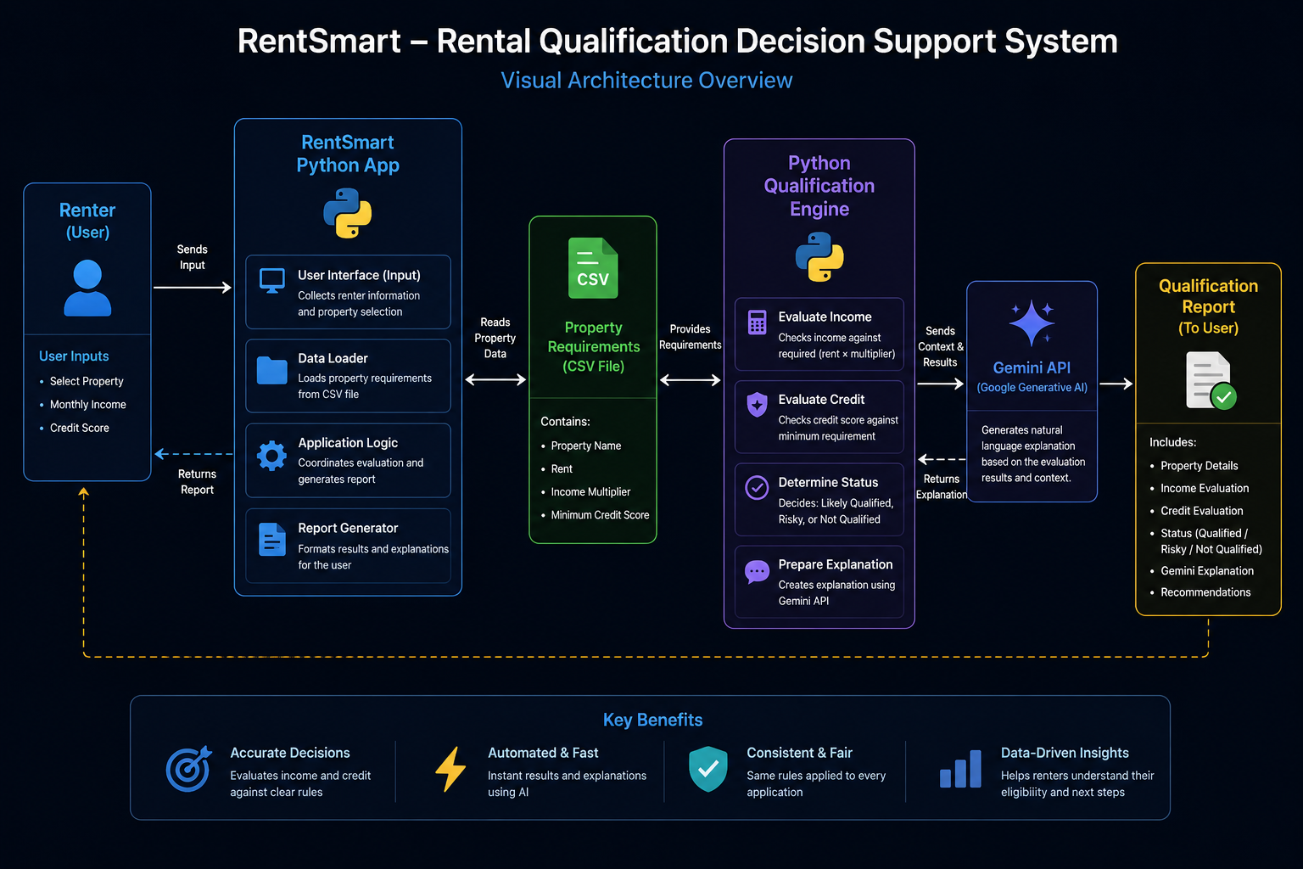
SYSTEM DESIGN
Visual Demo

Slide 9
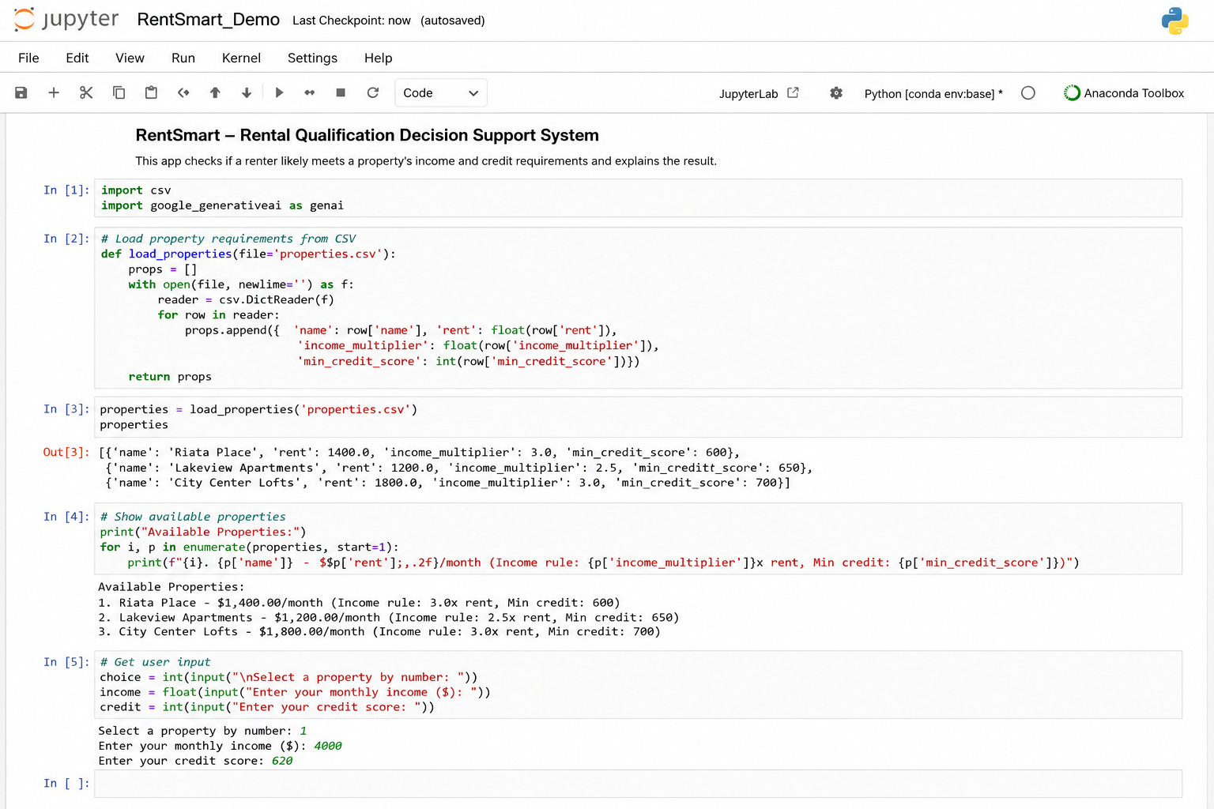
APPLICATION DEMO
Prototype Code Demo in Jupyter Notebook

Slide 10
DEMO WALKTHROUGH
What the Demo Proves
1. DATA
CSV stores each property's rent, income multiplier, and minimum credit score.
2. INPUT
The renter selects one property and enters monthly income and credit score.
3. DECISION
Python calculates required income and evaluates the two qualification rules.
4. EXPLANATION
Gemini receives the completed result and explains it in plain language.
5. OUTPUT
The renter receives a transparent preliminary report: Likely Qualified, Risky, or Not Qualified.

